Slide 1
SCREEN SMART APP
IMAD PRACTICUM

Slide 2
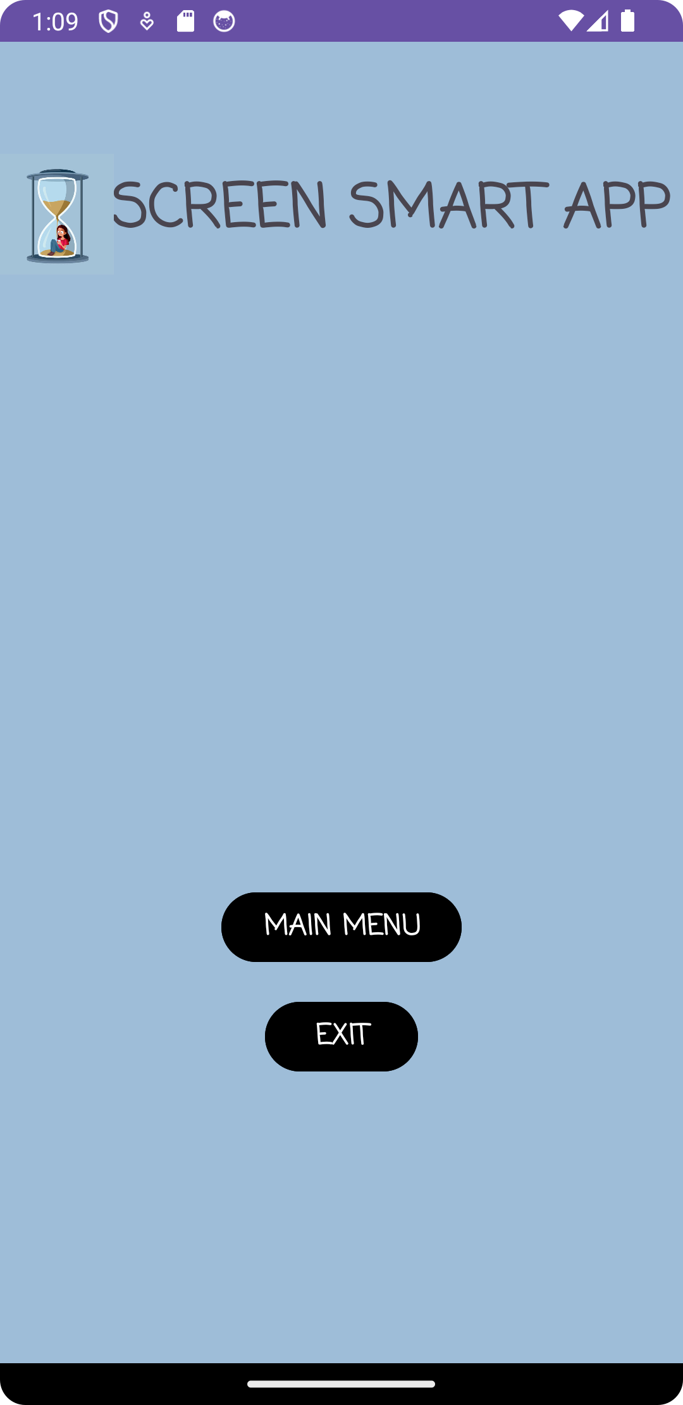
SPLASH SCREEN
Initial screen on start up of app
Includes two buttons (Main Menu and Exit)
Main Menu: Takes you the Splash Screen
Exit: Exits the app/ Closes the app

Slide 3
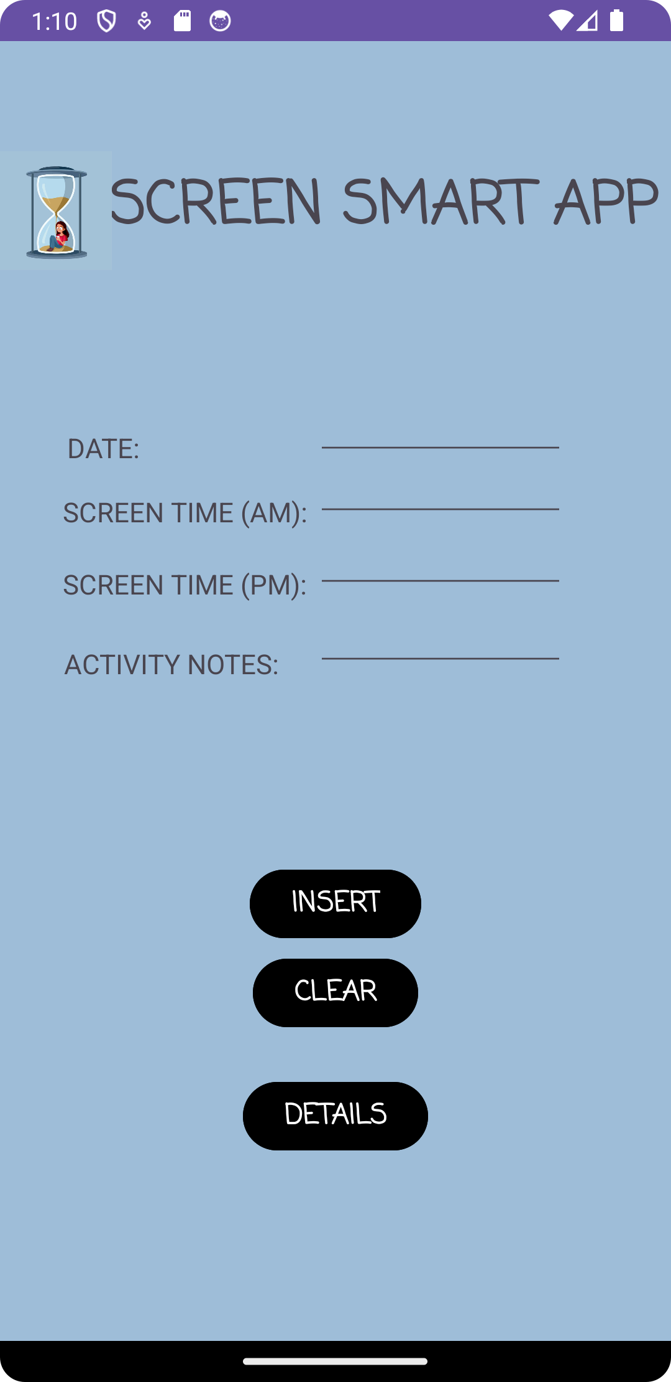
MAIN SCREEN
Includes 3 buttons (Insert, Clear, Details)
Insert: Stores user input
Clear: Used to clear input from text views
Details: Takes us to the Detailed View Screen
Here the user is required to enter in their data for :
Date: the date they are entering to record their screen time
Screen Time(AM): The no of mins the spent using their device in the morning
Screen Time(PM): The no of mins the spent using their device in the afternoon
Activity Notes: how they spent their screen time

Slide 4
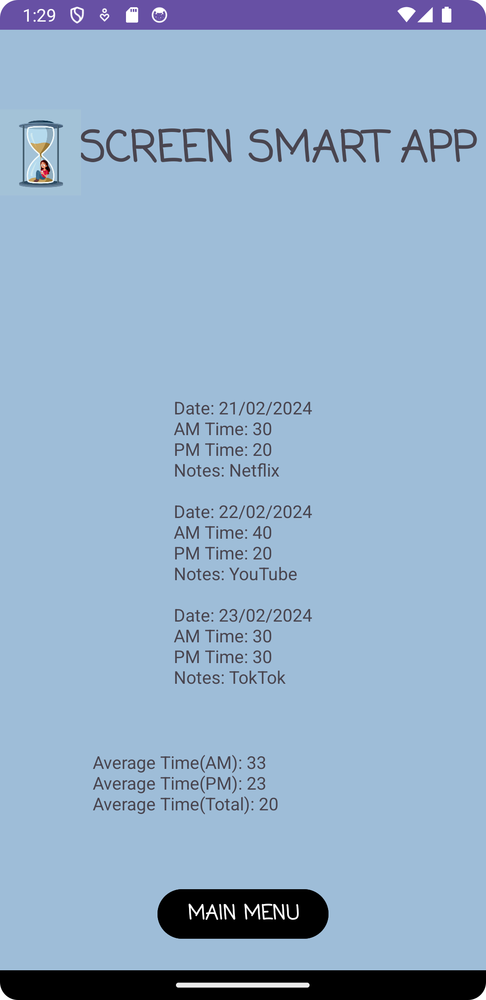
DETAILED VIEW SCREEN
This screen contain one button (Main Menu)
Main Menu: Used to return to the splash screen
This screen does the following:
Displays the user’s records
Displays the average screen Time

